Slide 1
Skills Matrix
WebApp GUI For Users Skills

Slide 2
TABLE OF CONTENTS
01
Skills database
02
ERD visualization
03
Used Technology
04
GUI
Describing entities & attributes
Visualizing relation between our entities
Describing technology used
Visualizing our GUI

Slide 3
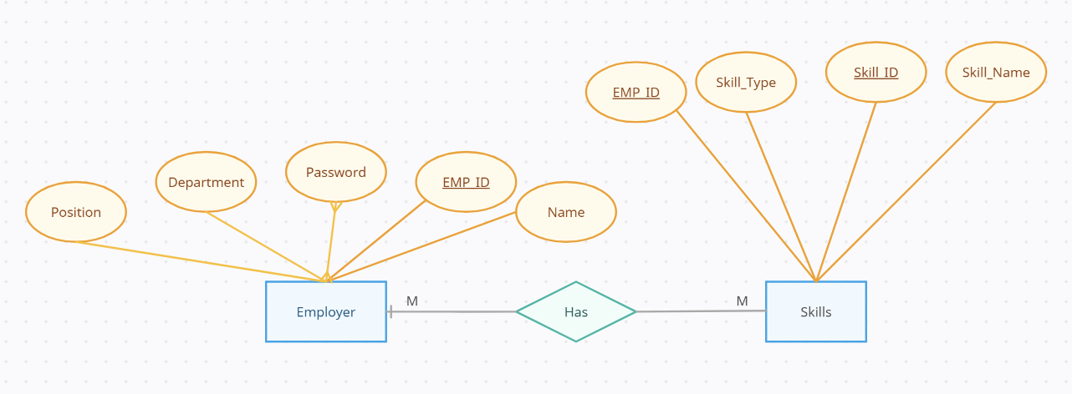
Conceptual ER Diagram

Slide 4
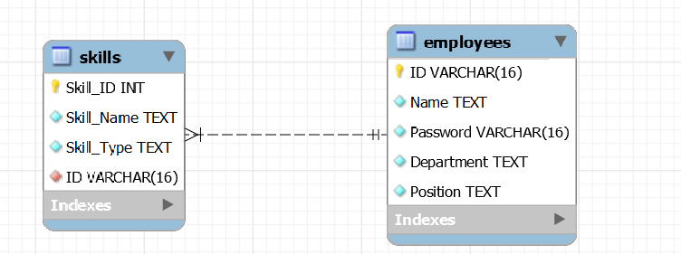
Physical ER Diagram

Slide 5
Used Technology
PhpMyAdmin.
Streamlit Library.
SQL workbench.
Git & GitHub.

Slide 6
THANKS!
Presented by:
Omar Saad
Mostafa Kamal
Ahmed Kamal
Osama Yousif
Maisara Akef
Nardin Radany

